Slide 1


APACHE SPARK DEEP DIVE -----HashPartitioner in Spark---

Slide 2
HashPartitioner
There are two partitioners provided by the spark:
Hash Partitioner
Range Partitioner
Today , we will discuss about the Hash Partitioner

Slide 3
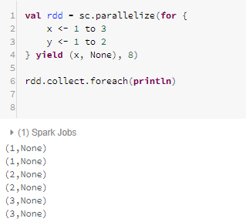
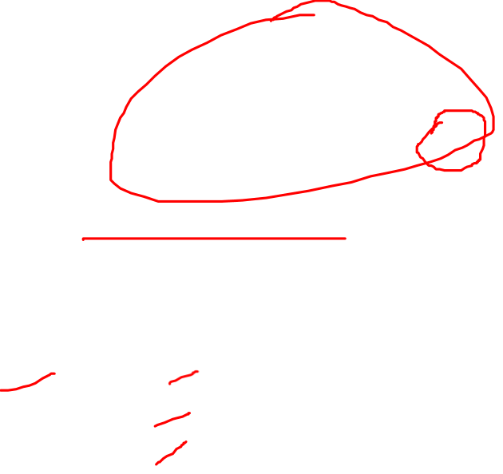
HashPartitioner
Let understand with the example, create an RDD :

Slide 4
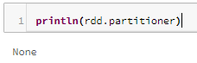

HashPartitioner
Find the Partitioner : None : What is the Default Partitioner ?
Partitioning as distributing data between partitions depending on a value of the key which is limited only to the PairwiseRDDs (RDD[(T, U)]). This creates a relationship between partition and the set of keys which can be found on a given partition.
Partitioning as splitting input into multiple partitions where data is simply divided into chunks containing consecutive records to enable distributed computation. Exact logic depends on a specific source but it is either number of records or size of a chunk.
So default partitioning scheme is simply none because partitioning is not applicable to all RDDs. For operations which require partitioning on a PairwiseRDD (aggregateByKey, reduceByKey etc.) default method is use Hash partitioning.

Slide 5
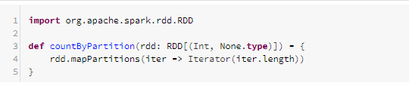
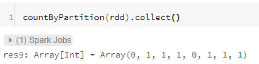
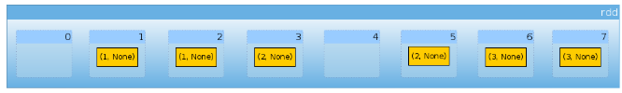

HashPartitioner
Now lets define small helper to count number of elements per partition:

Slide 6
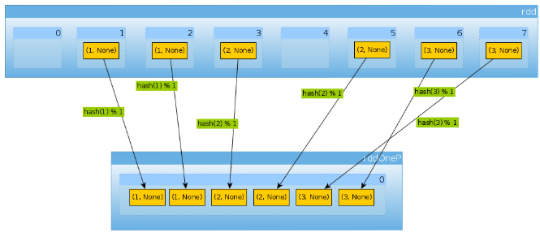

HashPartitioner
Now lets repartition our dataset using Hash Partitioner :
Single Partition

Slide 7
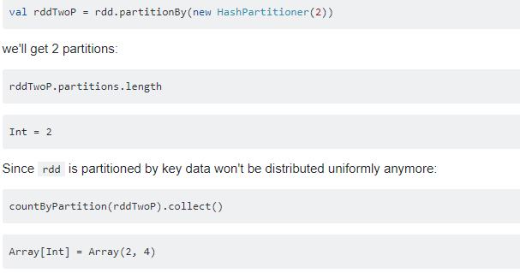
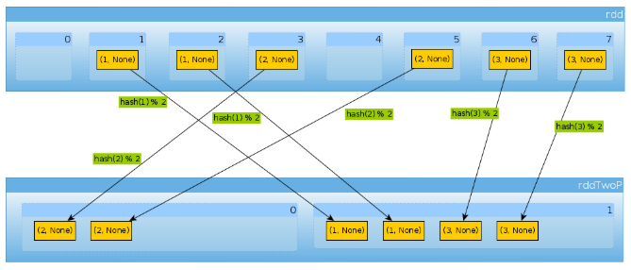
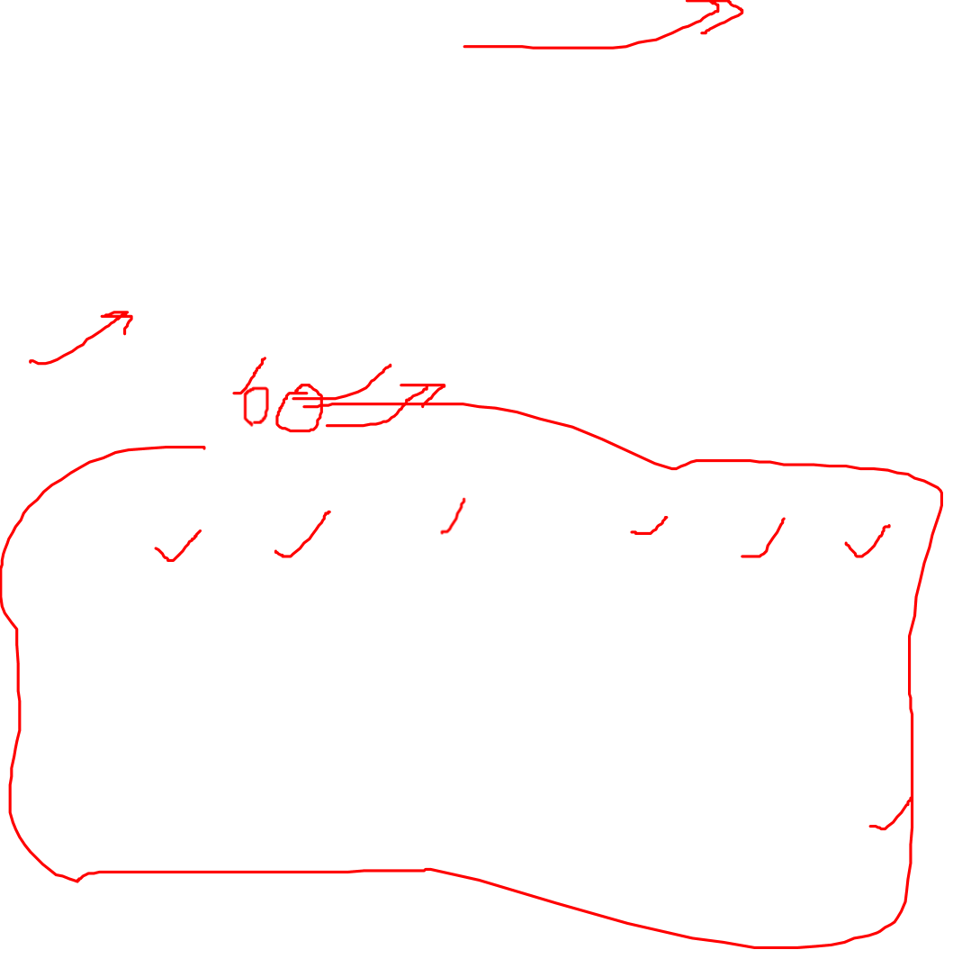
Now, we use HashPartitioner(2)
Partition-1
Partition-2

Slide 8
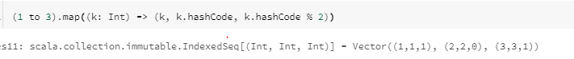

HashPartitioner
Now, we use HashPartitioner(2)
Because with have three keys and only two different values of hashCode mod numPartitions there is nothing unexpected here,let see how:

Slide 9
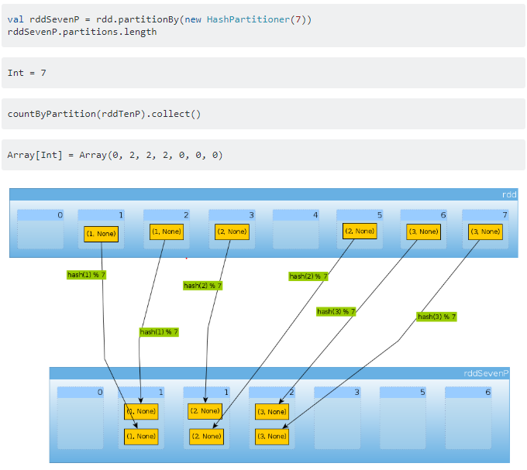
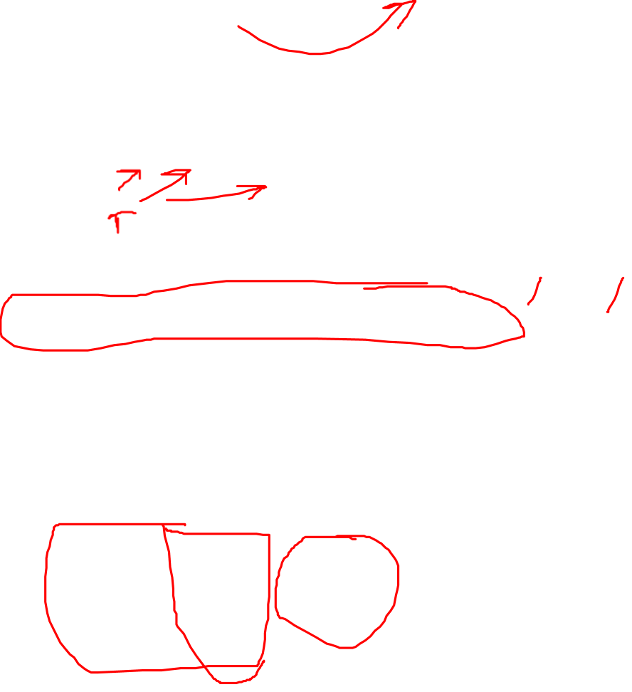
Now, we use HashPartitioner(7)

Slide 10
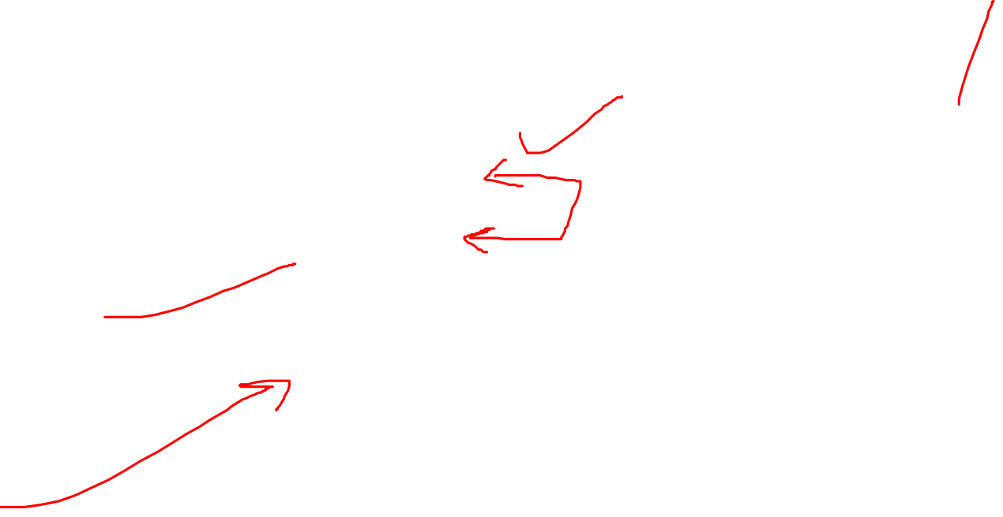
HashPartitioner : Conclusion
HashPartitioner takes a single argument which defines number of partitions.
Values are assigned to partitions using hash of keys. hash function may differ depending on the language (Scala RDD may use hashCode, DataSets use MurmurHash 3, PySpark, portable_hash).
Keys have to be hashable.
Hash partitioner is neither injective nor surjective. Multiple keys can be assigned to a single partition and some partitions can remain empty.
HashPartitioner (or any other Partitioner) shuffles the data. Unless partitioning is reused between multiple operations it doesn't reduce amount of data to be shuffled.

Slide 11
Thanks and do subscribe to my channel

